Slide 1

FACE M0NITORING SYSTEM FOR SAFETY MEASURES
Presented By-
Tushit Agarwal (1606810342)
Tavishi Gupta (1606810336)
Sparsh Gupta (1606810324)
Sidharth Jain (1606810321)
Under the guidance of:
Mr. Vishal Jayaswal

Slide 2
CONTENT
Introduction
About
Objective
Technology Stack
Algorithm Used
Working
Existing Systems
Future Scope

Slide 3
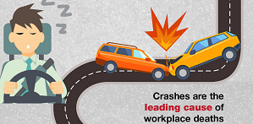
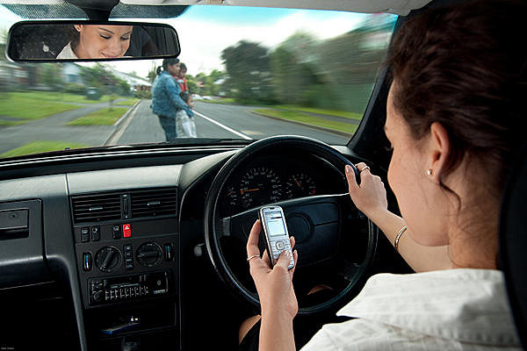
INTRODUCTION
“Drowsy driving” occurs when a person who is operating a motor vehicle is too tired to remain alert. As a result the driver may have slow reaction times, reduced vigilance and impaired thinking. In the worst case the driver may fall asleep behind the wheel.
According to a recent survey conducted by the World Health Organization, approximately 3700 people globally lose their lives daily in road accidents. Out of these, approximately, 20% death reasons are driver’s less consciousness on the road like distraction, drowsiness, fatigueness etc.

Slide 4
OBJECTIVES
Nowadays the driver and passengers safety in the car is one of the most wanted system to avoid accidents.
Our objective of the project is to ensure the safety systems. For enhancing the safety, we are detecting the eye blinks of the driver and estimating the driver status and control the car accordingly.
The objective of this project is to identify the current drowsiness detection by investigating flexible methods for studying the relationships between driver’s manoeuvre performances whiles the vehicle on the move and the physiological driver drowsiness states.

Slide 5




TECHNOLOGY STACK

Slide 6
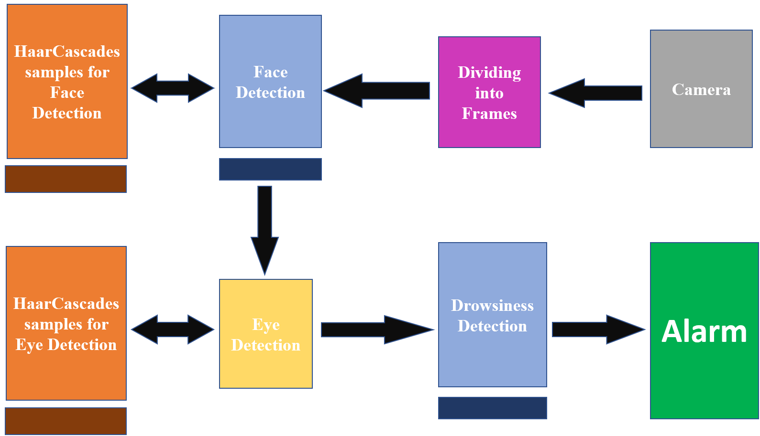
ALGORITHM USED

Slide 7
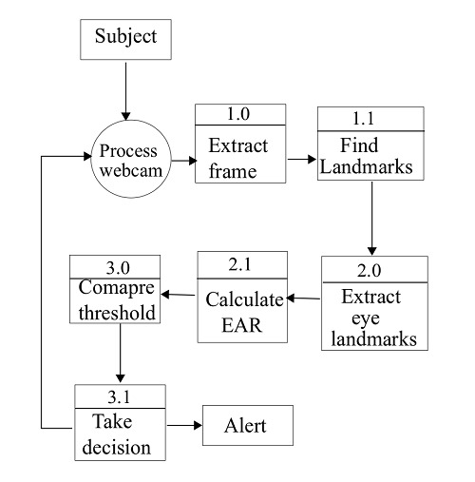
WORKING

Slide 8
SNAPSHOTS OF WORKING MODEL

Slide 9
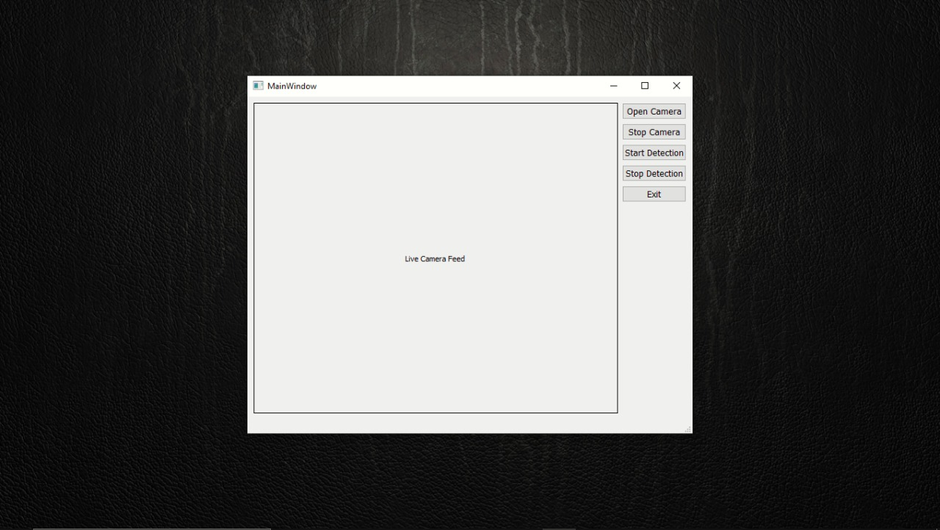
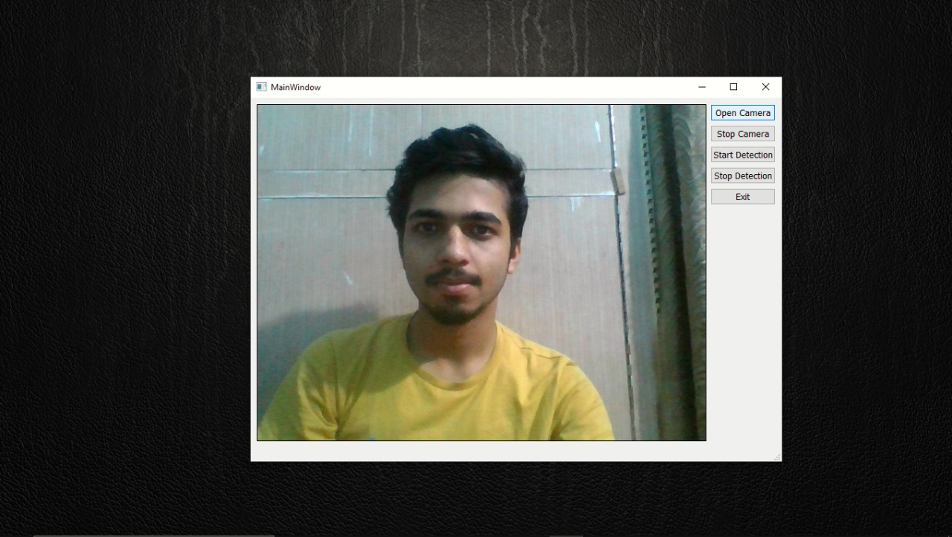
GUI DESIGN (FIRST GLIMPS, WHILE CAMERA IS OFF)
WINDOW WHILE CAMERA IS ON (START DETECTION IS OFF)

Slide 10
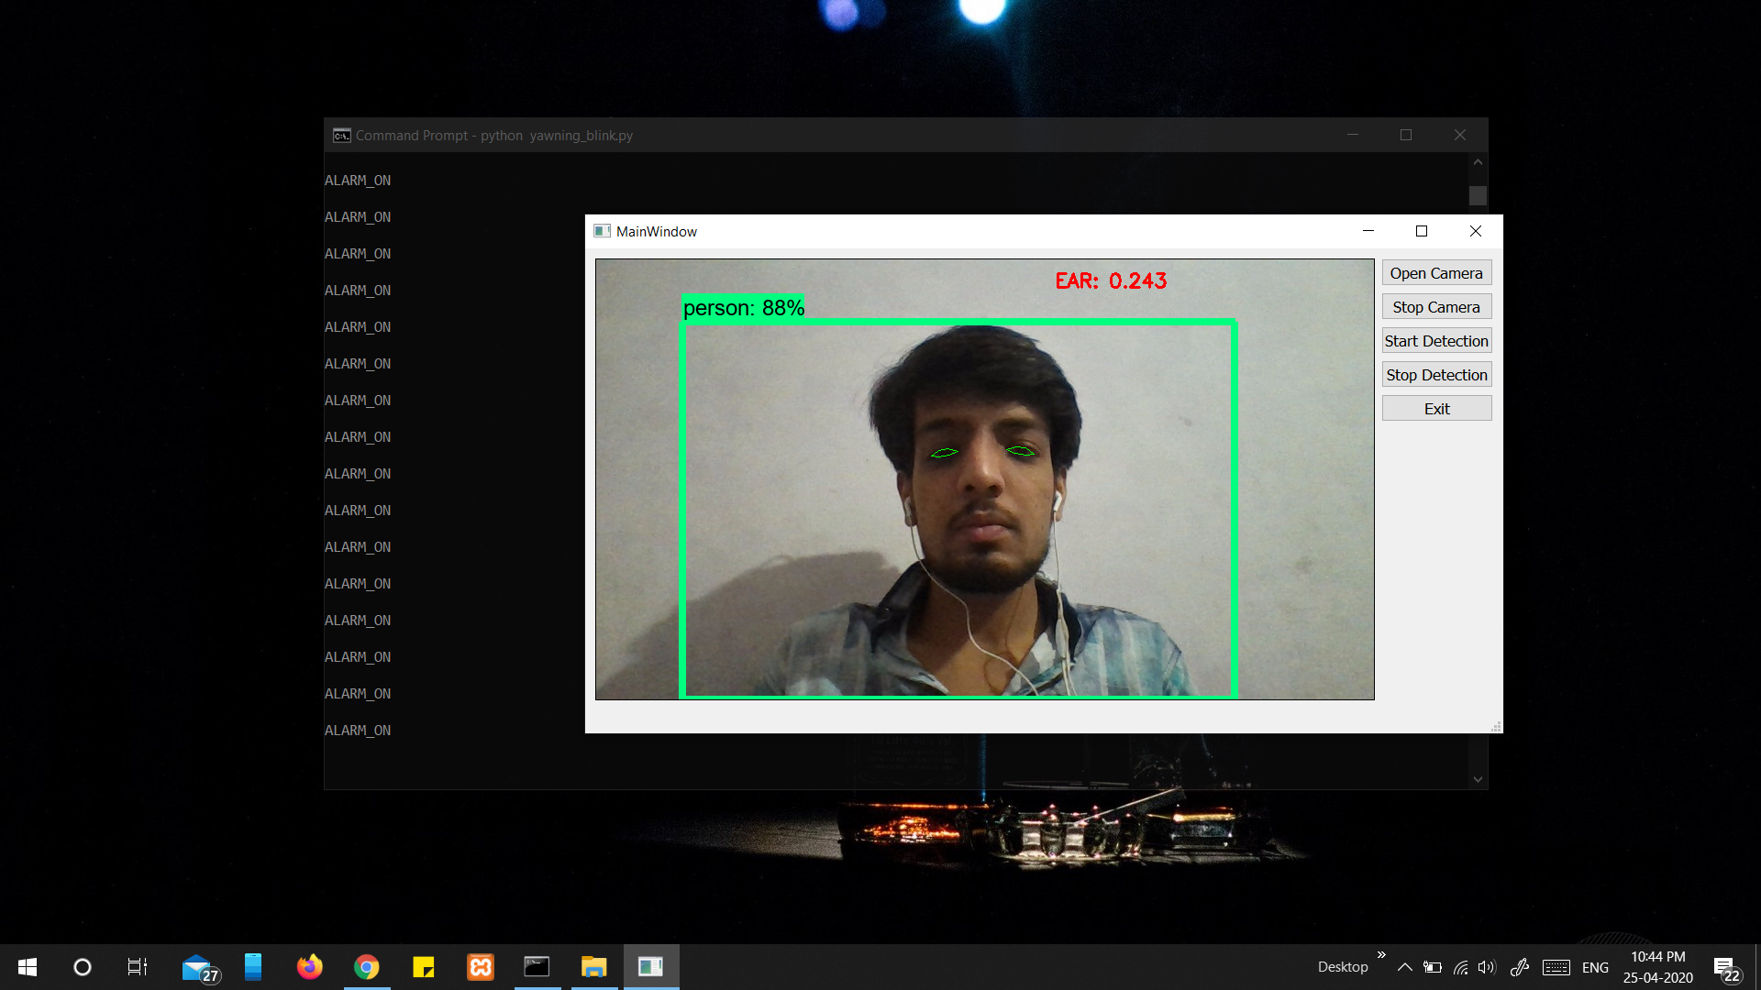
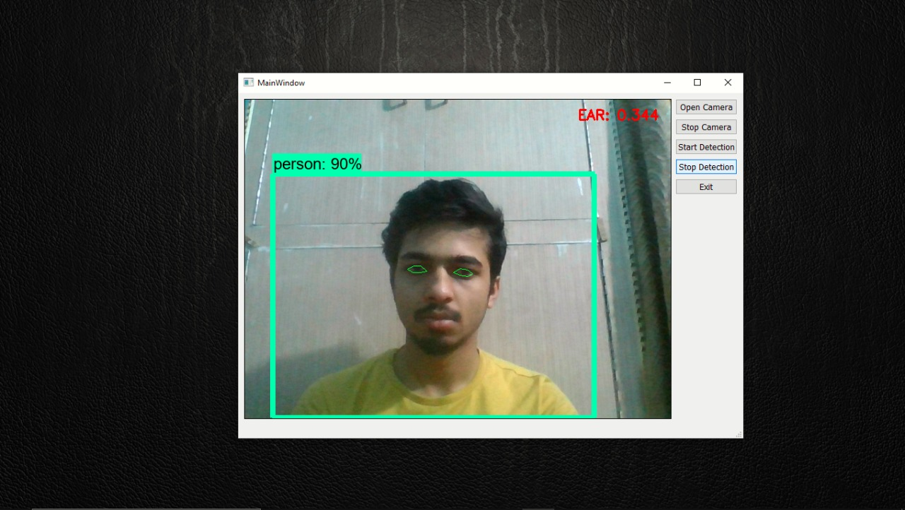
DETECTING FACE AND ITS FEATURES, CALCULATING VALUES AND PREDICTING RESULTS (START DETECTION IS ON)

Slide 11
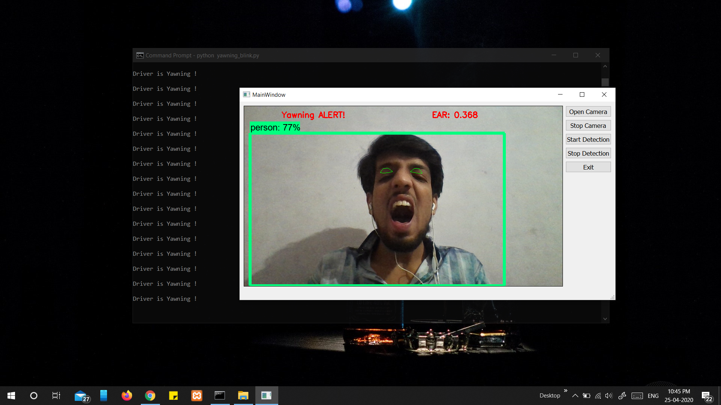
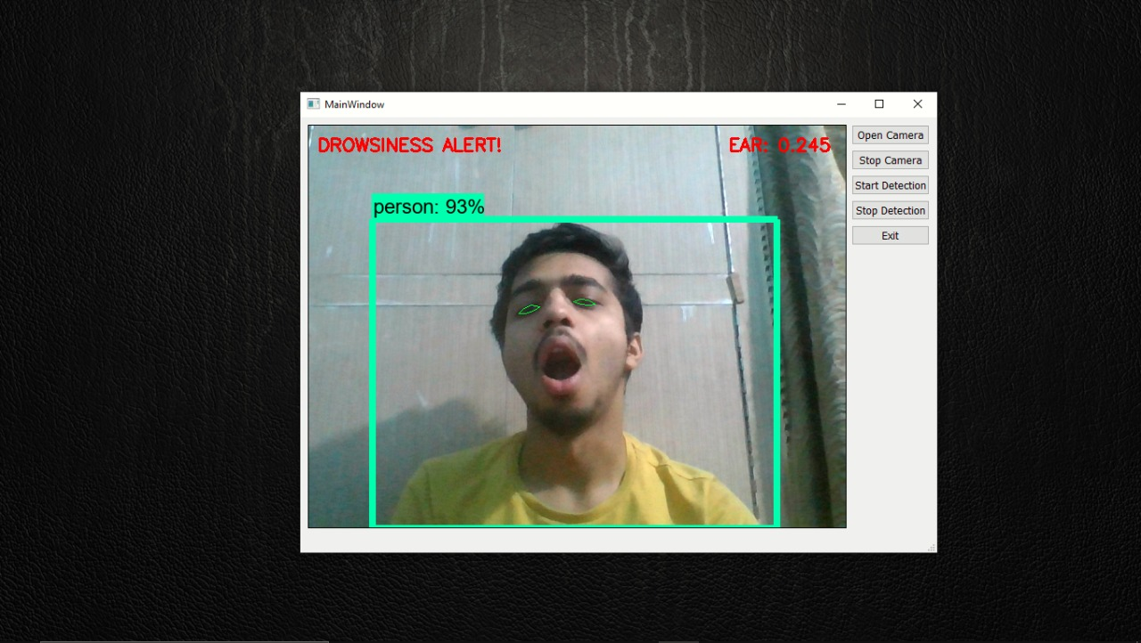
CASE I : OBJECT IS YAWNING, SYSTEM HAS DETECTED AND RAISES ALARM

Slide 12
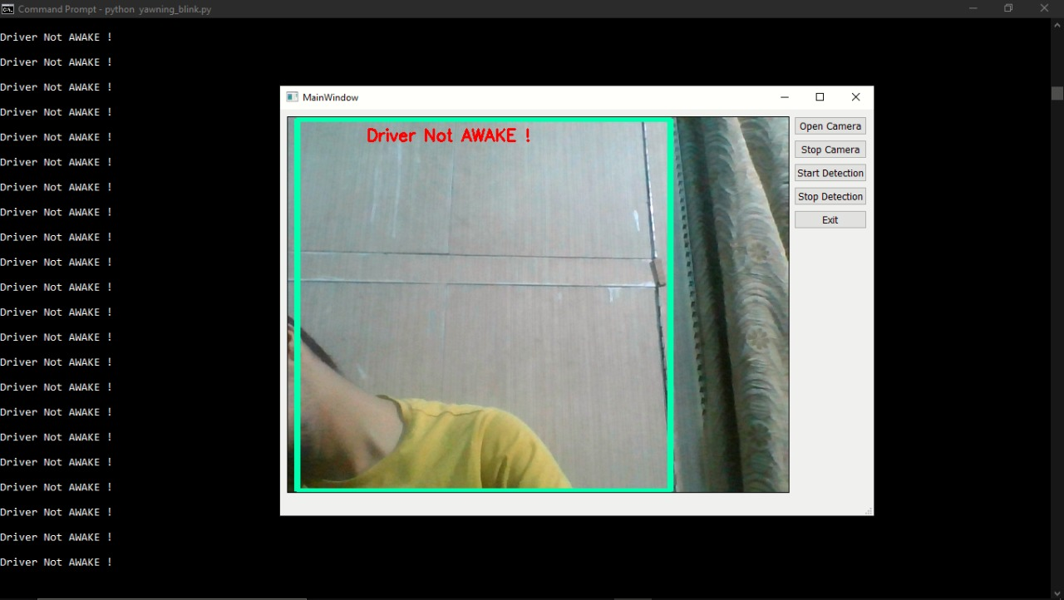
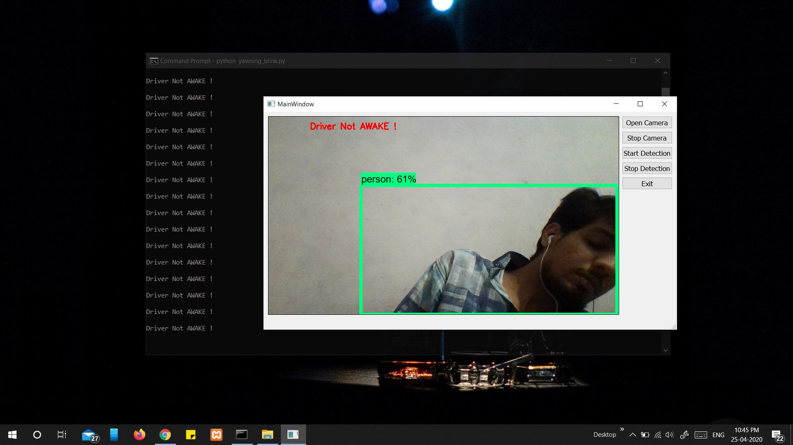
CASE II : OBJECT IS NOT IN FRAME, SYSTEM HAS DETECTED AND RAISES ALARM

Slide 13
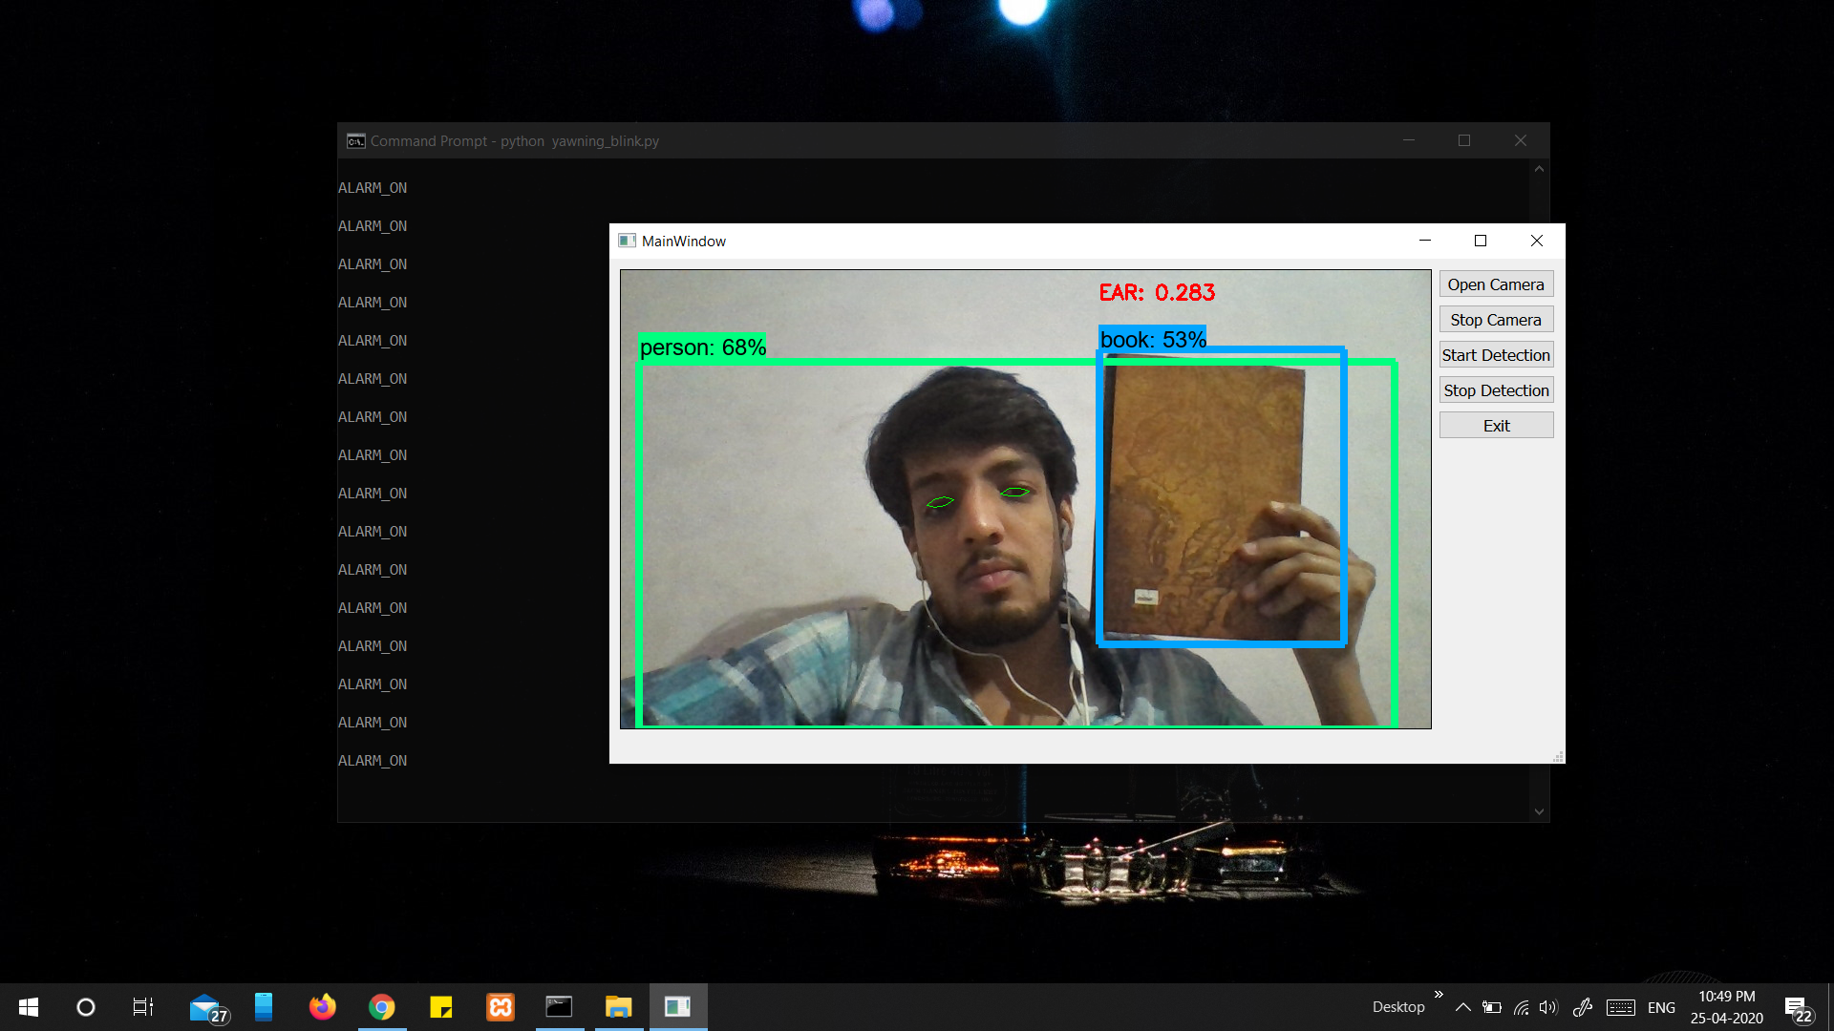
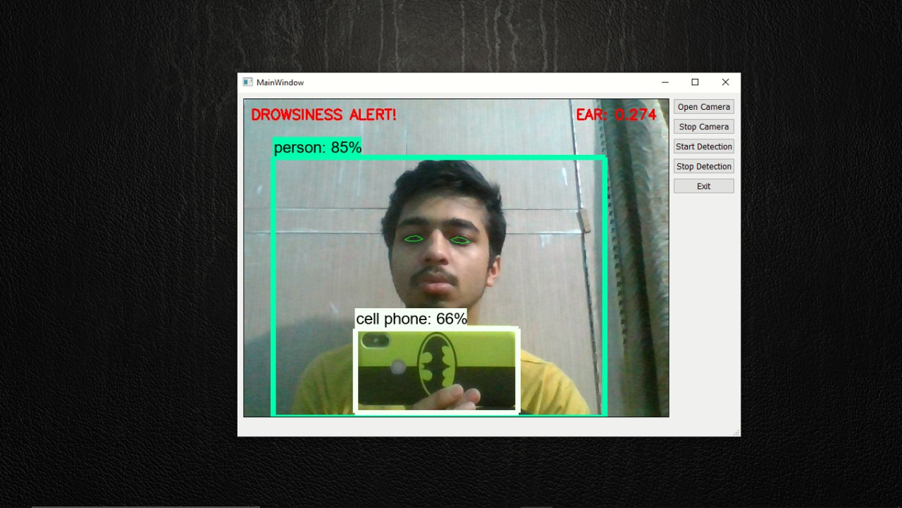
CASE III : OBJECT WHEN GET DISTRACTED BY SOME UNWANTED OBJECT, SYSTEM HAS DETECTED AND RAISES ALARM

Slide 14
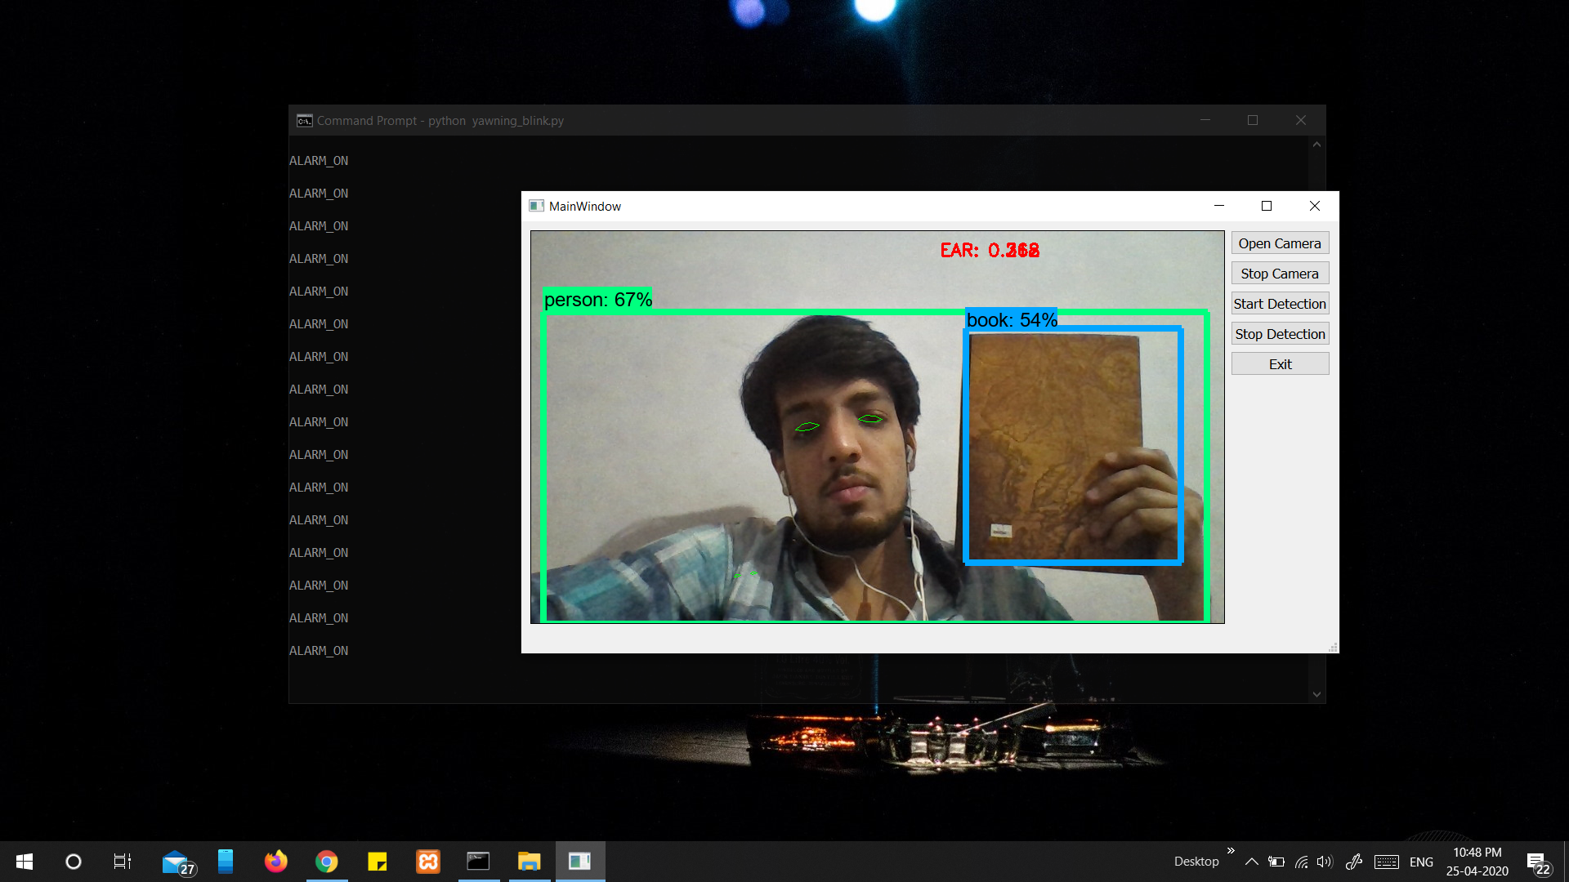
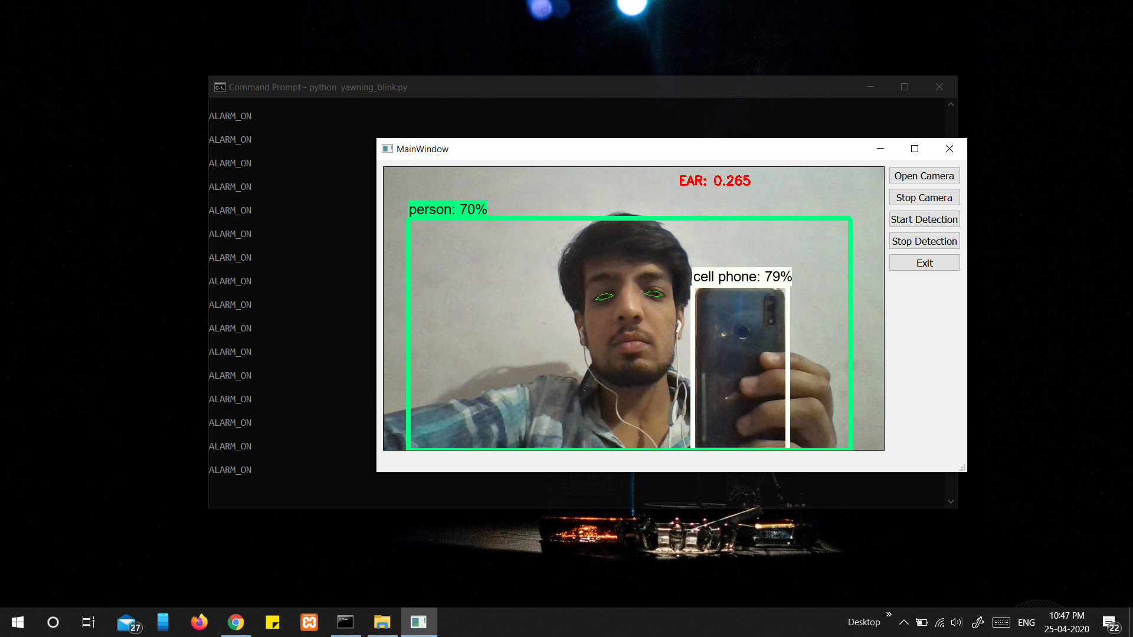
CASE III (EXTENDED) : SYSTEM IDENTIFIES ADDITIONAL COMMON OBJECTS FOR RECORDS

Slide 15
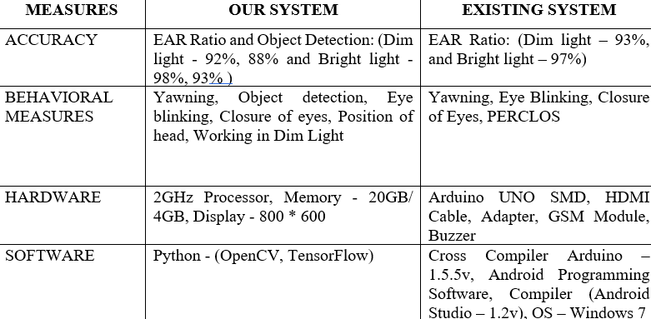
EXISTING SYSTEMS

Slide 16
FUTURE SCOPES
Our system has a wide scope further.
It can be directly integrated with any hardware system like Arduino to extend the functionality of the system.
It can be used in the system where high surveillance and monitoring is required with addition of high accuracy.
Security alerts where 24*7 security is required.
Can be used in medical examining and medical perfections.
Can be used in online examination monitoring.
Hassle free driving are some other aspects where it can be molded to make a better use of it.

Slide 17
Thank You!!

